Slide 1
How to live longer?
Author: Marco Lin

Slide 2
Agenda
Data cleaning
Exploration
Correlation
Clustering
K-Mean
KNN
Conclusion

Slide 3
Dataset source
From WHO (World Health Organization)
2000~2015
193 countries
2938 rows × 22 columns
Developing & Developed Countries

Slide 4
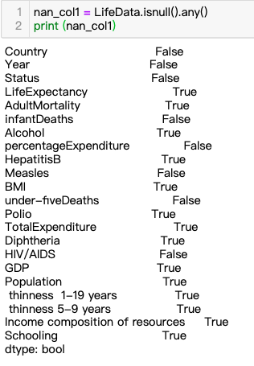
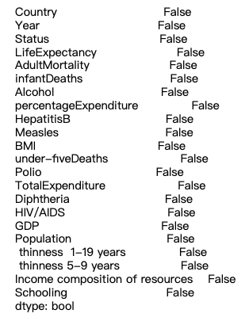
Data Cleaning
Before
After

Slide 5


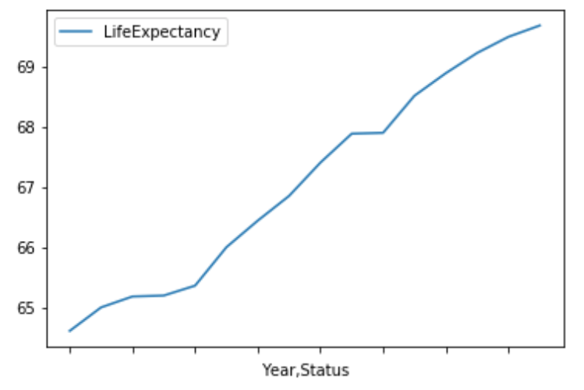
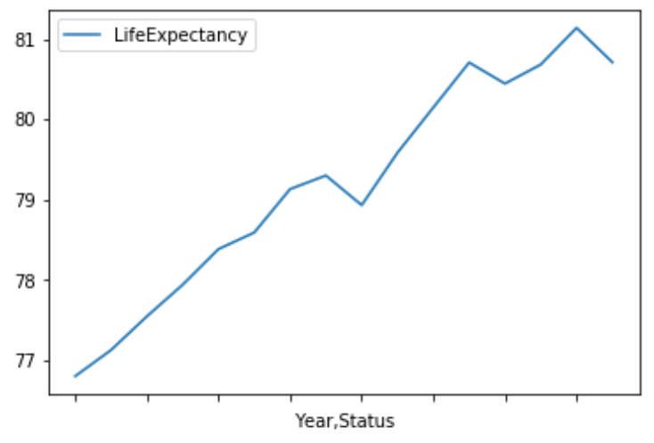



Data Exploration -Life Expectancy
Developing Countries
Developed Countries
2000~2015
2000~2015

Slide 6
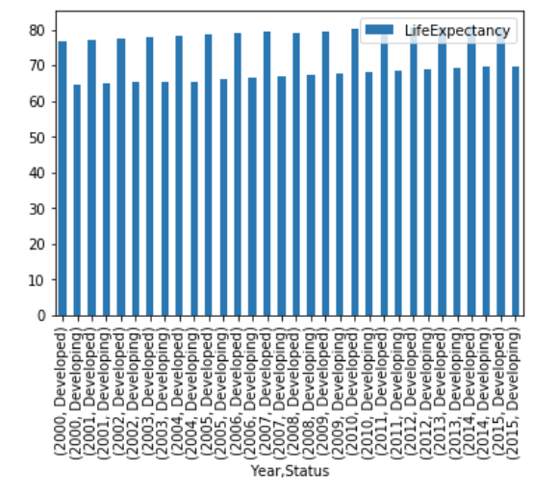
Life Expectancy Difference in two type of country.

Slide 7
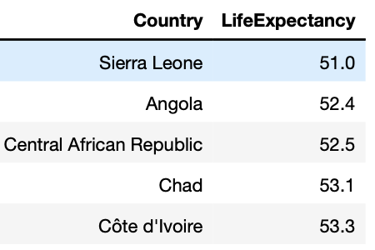
Lowest Life Expectancy in Developing Country

Slide 8
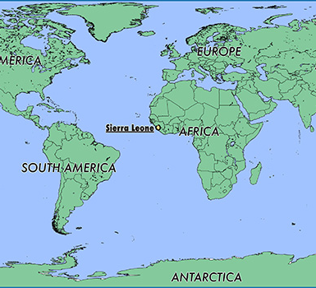
Sierra Leone

Slide 9
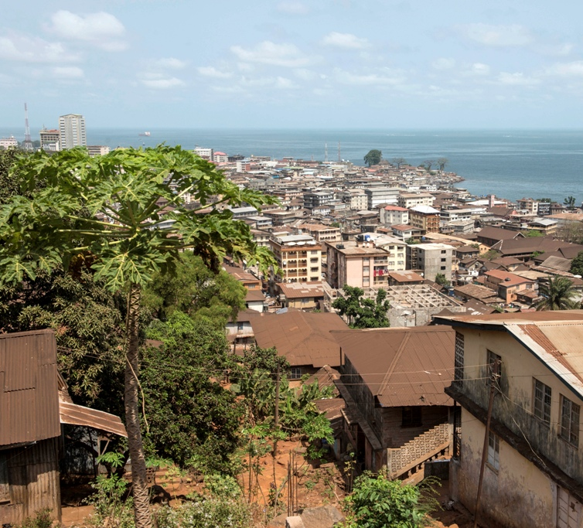
Sierra Leone

Slide 10
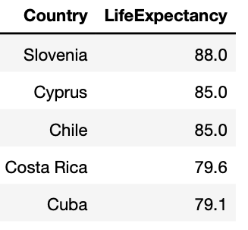
Highest Life Expectancy in Developing Country

Slide 11
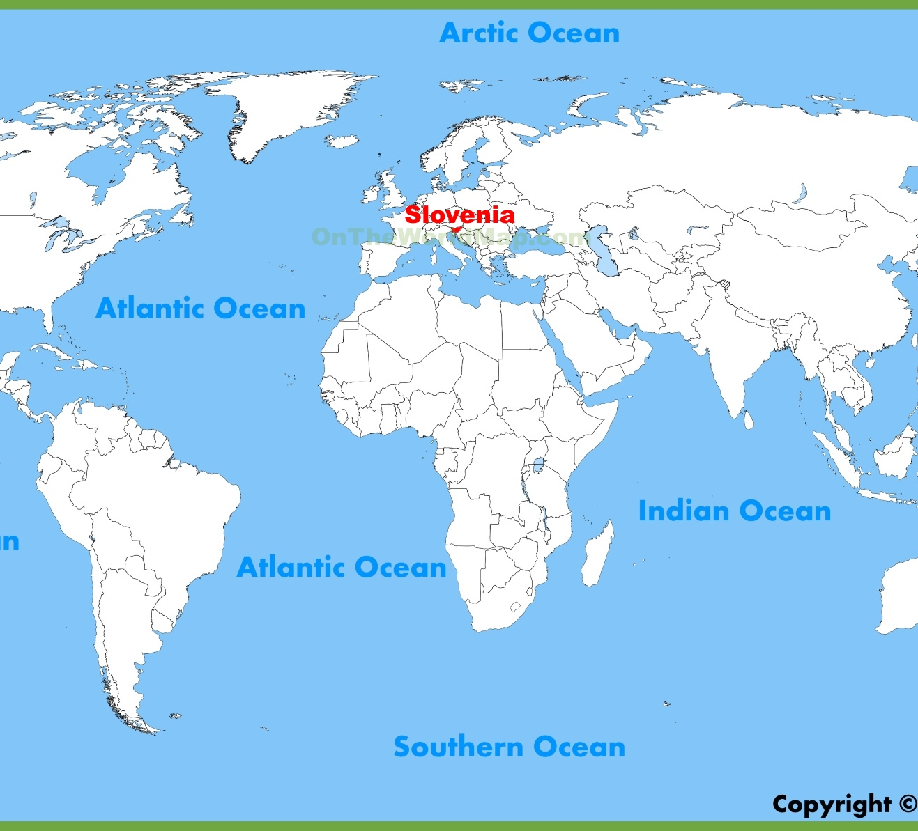
Slovenia

Slide 12
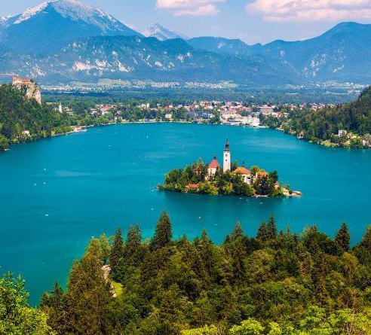
Slovenia

Slide 13
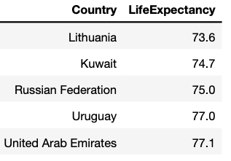
Lowest Life Expectancy in Developed Country

Slide 14
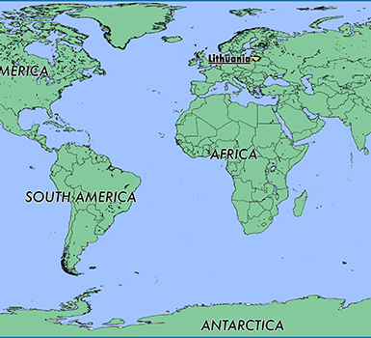
Lithuania

Slide 15
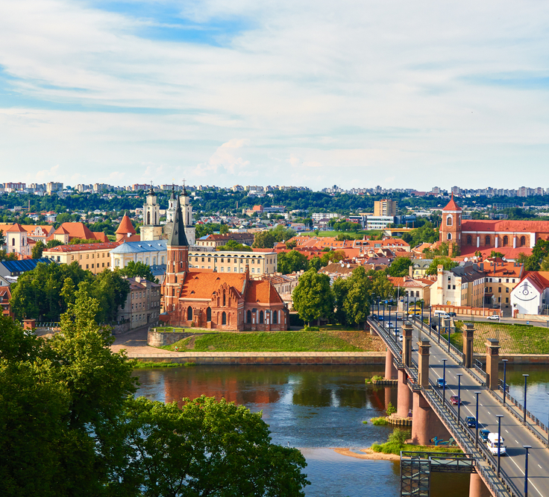
Lithuania

Slide 16
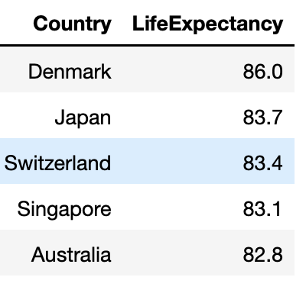
Highest Life Expectancy in Developed Country

Slide 17
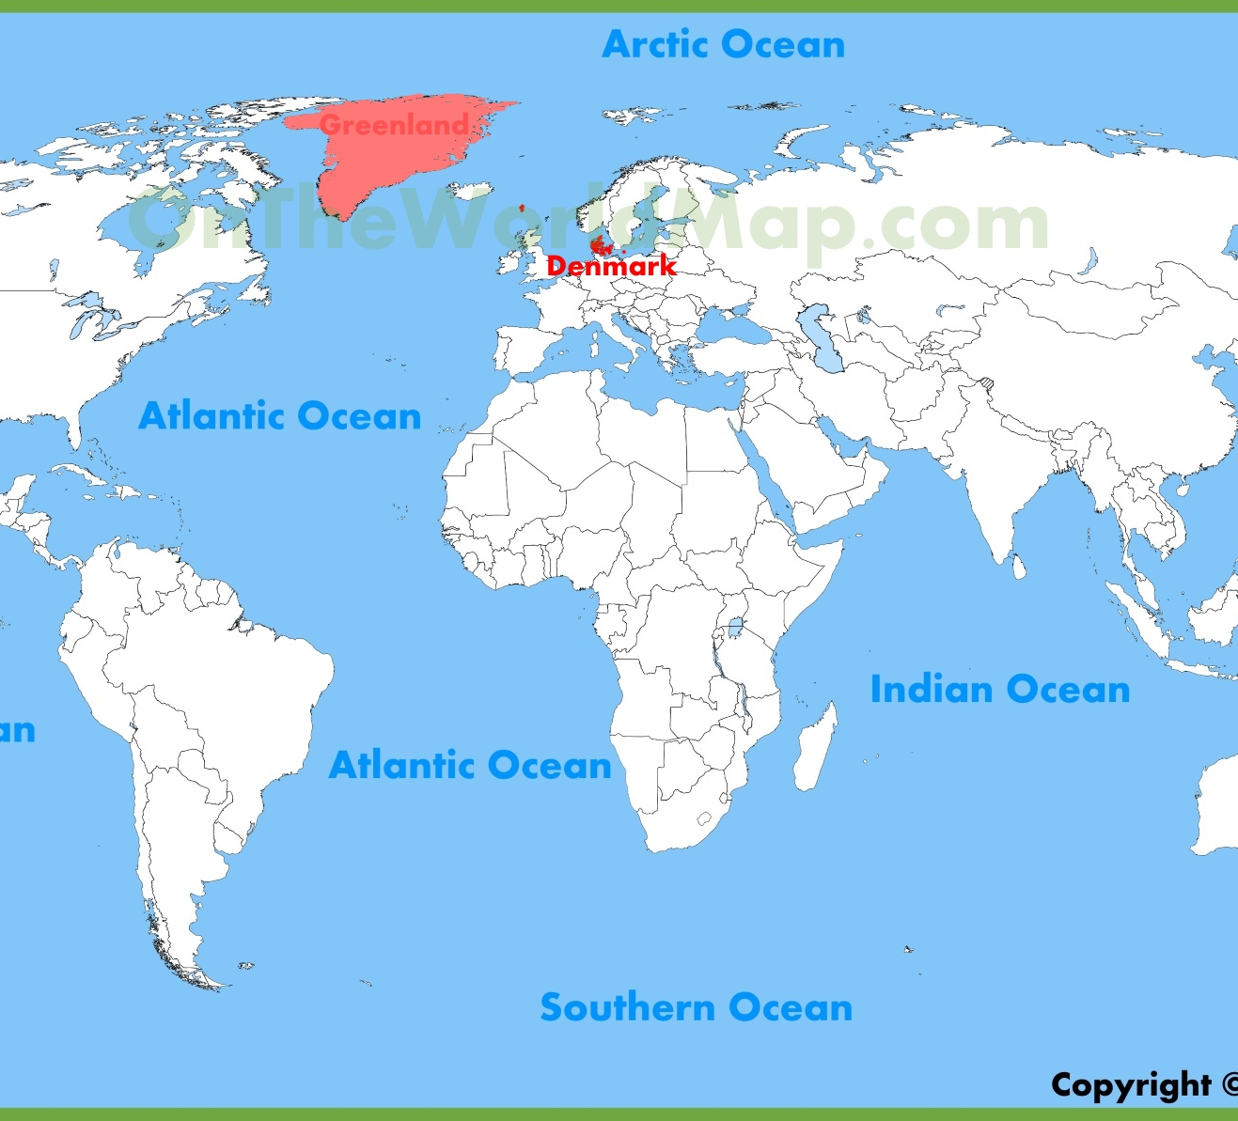
Denmark

Slide 18
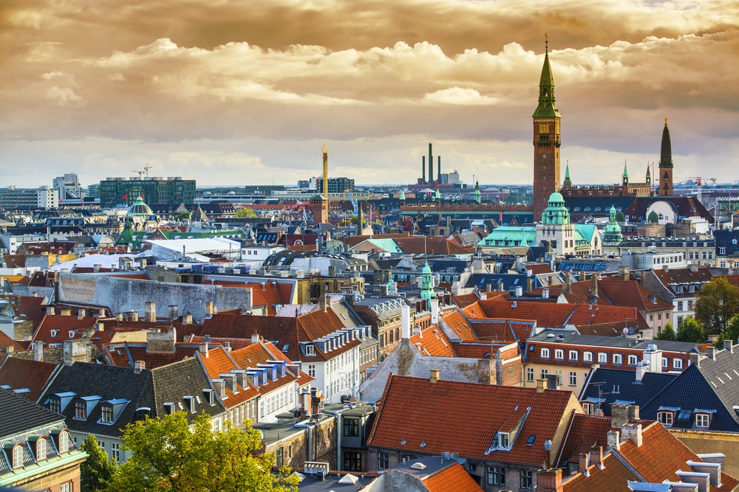
Denmark

Slide 19
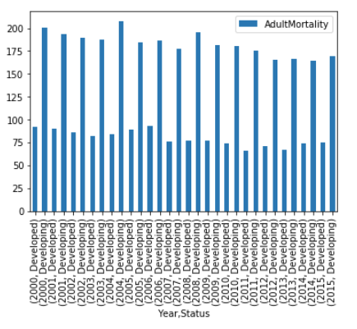
Adult Mortality Tendency in developed and developing countries

Slide 20
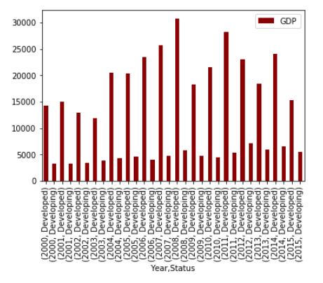
GDP tendency in Developing and Developed Countries

Slide 21
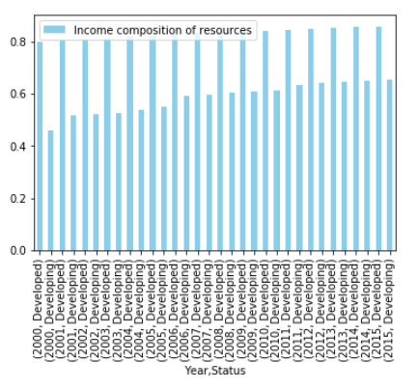
Income composition of resources

Slide 22
Correlation
Alcohol
Disease
GDP

Slide 23
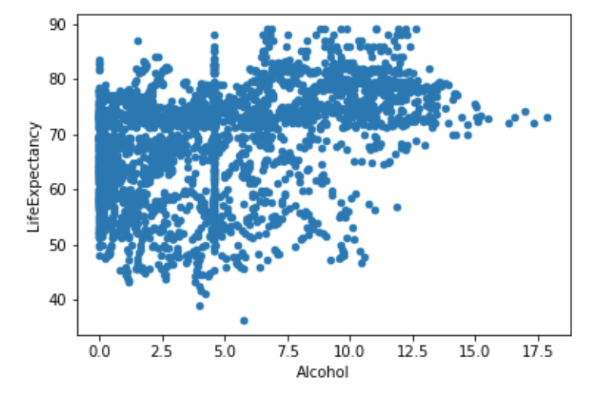
Alcohol is bad ?

Slide 24
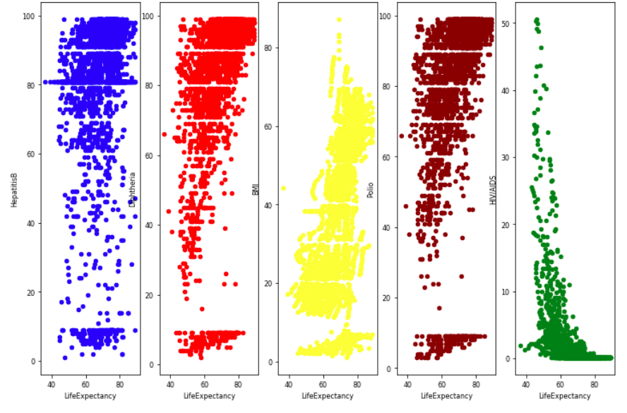
A. HepatitisB B. Diphtheria C. BMI D. Polio E. HIV/AIDS

Slide 25
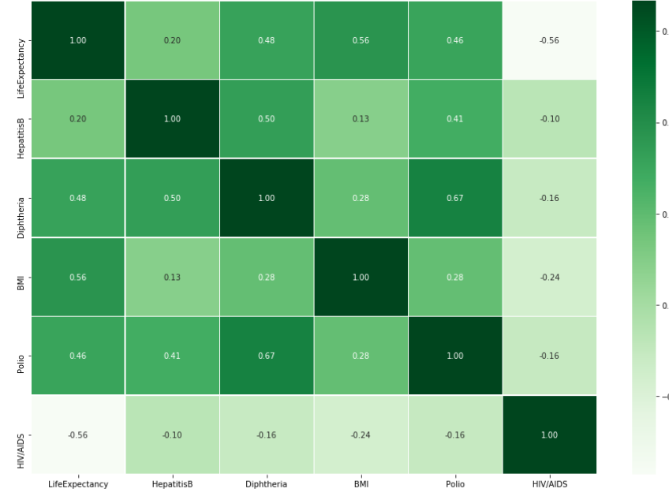
Disease and Life Expectancy
BMI: 0.56
Diphtheria: 0.48
Polio: 0.46

Slide 26
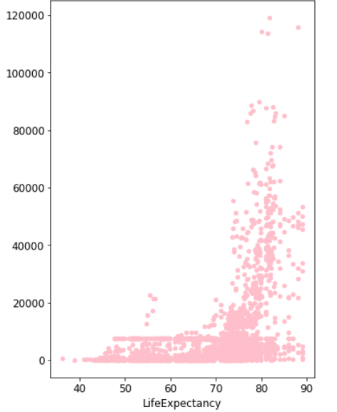
GDP and Life Expectancy

Slide 27
Cluster - Dendrogram
Normalization
Distance
Classification

Slide 28
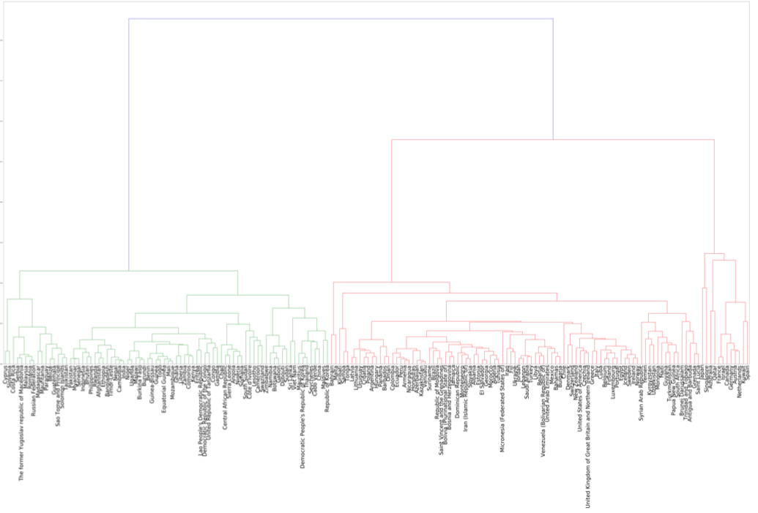
Dendrogram

Slide 29
K-Mean
To classify countries into 3 groups: Hight Middle, and Low Life Expectancy.
Helps us to identify easily what the level of life expectancy the countries belong to.

Slide 30
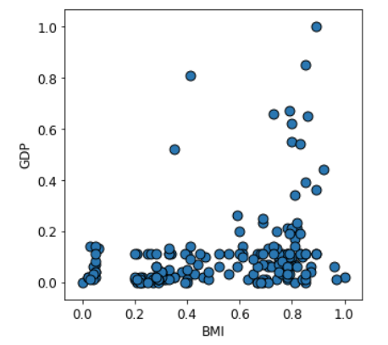
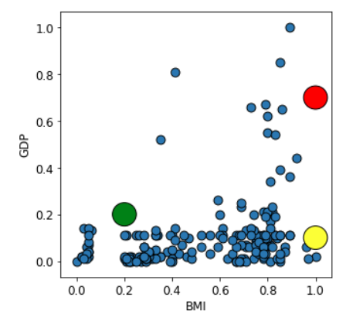
K Mean - Iteration

Slide 31
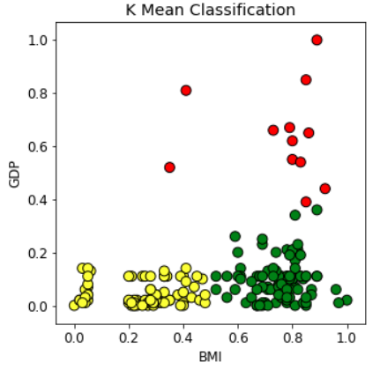
K Mean – Iteration
Red group:
Hight GDP & Hight BMI
green group:
Low GDP & Hight BMI
Yellow group:
Low GDP & Low BMI

Slide 32
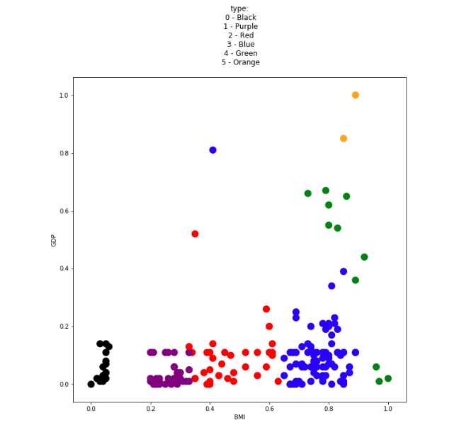
KNN – Data Visualization

Slide 33
Conclusion
Future work
Improvement
GDP
BMI
More Data
Accuracy

Slide 34

Thank you !

